Slide 1
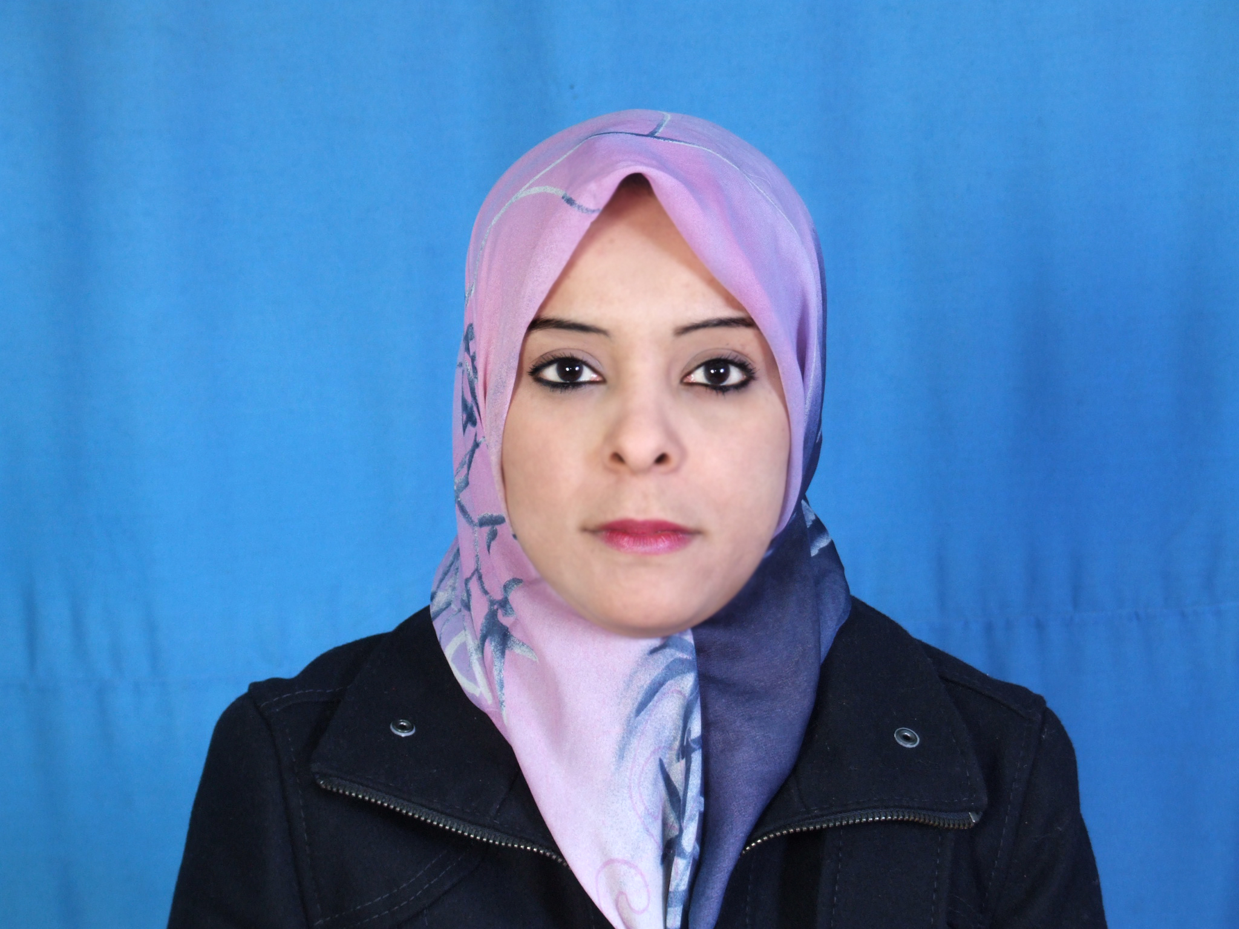

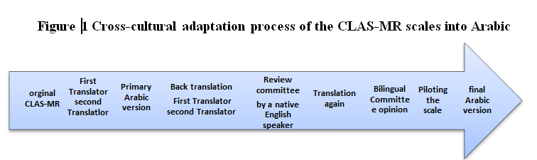
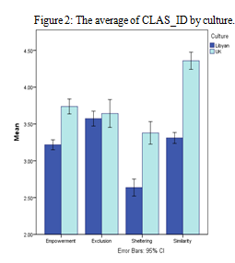
A cross cultures Attitudes towards people with Intellectual Disability
Aisha A M Benomir
Aishaonline_2010@yahoo.com
The University of Sheffield (UK)
Student’s sponsor: University of Sebha (Libya)
INTERUDUCTION:
It is estimated that from 3% to 10% of the world population suffer from some kind of disability ,This percentage of disability in the developing countries is as high as 12.3%; while World Health Organisation put the percentage of disability as 10% of the world population (80% of which is in the developing countries (Karr, 2011). Daruwalla & Darcy( 2005)has pointed out that Disability is not a problem or an obstacle within the disabled him/herself, but is also an obstacle within the other(s) who deny the possibility of readjustment and rehabilitation of those people with ID and reintegrating them into the society.
OBJECTIVE:
RESEARCHE QUESTIONS
This study aims to measure the attitudes of the staff in special schools/students (in Libya and the UK) toward people with intellectual disability and if they are affected by:
o Gender (male, female)
o Participants’ roles (University Students & staff at special schools)
o Their background (Mathematics & Psychology students)
o The daily contact with people with Intellectual Disability ( ID)
A methodology had to be formulated to test a number of questions:
Q1. What kind of attitudes the Libyans and the UK (students/ staff) have towards people with
ID Empowerment, Inclusion of people with ID, people with ID Sheltering and Similarity with people with ID?
Q2. Are there any significant differences among the Libyan and the UK attitudes according to
gender (Males/ Females) towards Empowerment Inclusion, Sheltering and Similarity?
Q3. Are there any significant differences among the Libyan and the UK attitudes according to
their demographic backgrounds (psychology /mathematics students & ID’s staff) towards Empowerment Inclusion, Sheltering and Similarity?
DISIGN:
CONCLUSIONS:
The study was designed as a cross-cultural study of attitudes to intellectual disability in Libya and in the UK. two studies were planned, one in Libya and one in the UK, using the CLAS-MR. Given that most of the research to date has been undertaken with students or within members of the public, I considered important to examine attitudes students population, with the additional refinement of investigating two different disciplines. For the Psychology discipline one would expect a greater understanding of issues of individual differences, intellectual disability, and the importance of positive attitudes, thereby indirectly reducing the social distance from people with ID. By contrast, one would expect students of the natural sciences to have a less well-developed understanding of such issues, and therefore an effectively increased social distance. As a further sector, I also wished to investigate professionals at special schools.
A random samples from Libya & the UK were tested by The Community Living Attitudes Scale – Mental Retardation (CLAS-MR) scale. ,For recent terminology, the term mental retardation was replaced by Intellectual Disability The Community Living Attitudes Scale – Intellectual disability (CLAS-ID). Several US-centric phrases were considered inappropriate for a British respondent, and changes were therefore made as appropriate. For the Arab participants there was no available version of the CLAS-MR in Arabic, therefore it was necessary to create one. I used a multi-step translation following the recommendations of Bracken & Barona, (1991), so as to obtain a valid, robust and reliable instrument as shown See figure 1.
RESULTS:
A cross cultural investigation using Demographic integration, gender, role and Academic Discipline, were measured in order to check their influence on the attitude towards people with ID. The study showed that there were significant differences between Libyan and the British samples the British have more favourable attitudes towards Empowerment, Sheltering and Similarity for people with ID.
The study showed there were significant differences between Libyan and the British samples. The British sample had more favourable attitudes towards Empowerment and towards Sheltering and towards Similarity of people with ID, whereas there was no significant difference between Libyan and the British samples in their attitudes to Exclusion of people with ID. This study established significant Cultural differences by gender interaction effects for Empowerment (with the UK males giving a higher value and the Libyan males giving a lower value than the females). In terms of Role, several previous studies have measured the influence of job in attitude towards disability but none of them has compared between staff at special schools and university students. There were significant interactions between Culture and Role for Empowerment (with the UK students providing much higher scores than the UK staff, whereas there was no difference between students and staff in Libya). There was a significant interaction for Exclusion, caused by the UK students having very much lower (more favourable) scores. There was also a significant crossover interaction for Sheltering; with the UK students got a higher score than the UK staff, and vice versa for the Libyan sample. A similar interaction also occurred for Similarity; again the UK students have considerably more favourable attitudes. In terms of Academic Discipline, a comparison was conducted between psychology students and mathematics students. There were significant interactions between Culture academic discipline for Exclusion, involving a cross-over effect the UK mathematics students being more in favour of inclusion, and the UK Psychology students more in favour of Exclusion than the two Libyan student groups. There was a related interaction for Sheltering, with the UK maths students more in favour than the UK Psychology students, and vice versa for the Libyan groups, but overall there was a more positive attitude for Sheltering in the UK student groups.
ACKNOWEDDGMENT
I would take this opportunity to thank my rеsеаrch supеrvіsors Rod Nicolson and Nigel Beail, My mum, my frіеnds, and special thanks for my husband Mohamed Busefi, Abdollha Benomair аnd Ebtehal Omar intesar Omar for thеіr support аnd guіdаncе wіthout whіch thіs rеsеаrch would not hаvе bееn possіblе
REFERNCES
Bracken, B. a., & Barona, a. (1991). State of the Art Procedures for Translating, Validating and Using Psychoeducational Tests in Cross-Cultural Assessment. School Psychology International, 12(1-2), 119–132.
Daruwalla, P., & Darcy, S. (2005). Personal and societal attitudes to disability. Annals of Tourism Research, 32(3), 549–570.
Henry, D., Keys, C., & Jopp, D. (1998). The Community Living Attitudes Scale – Mental Retardation Version Reference Manua. University of Illinois at Chicago,Chicago.

